Slide 1
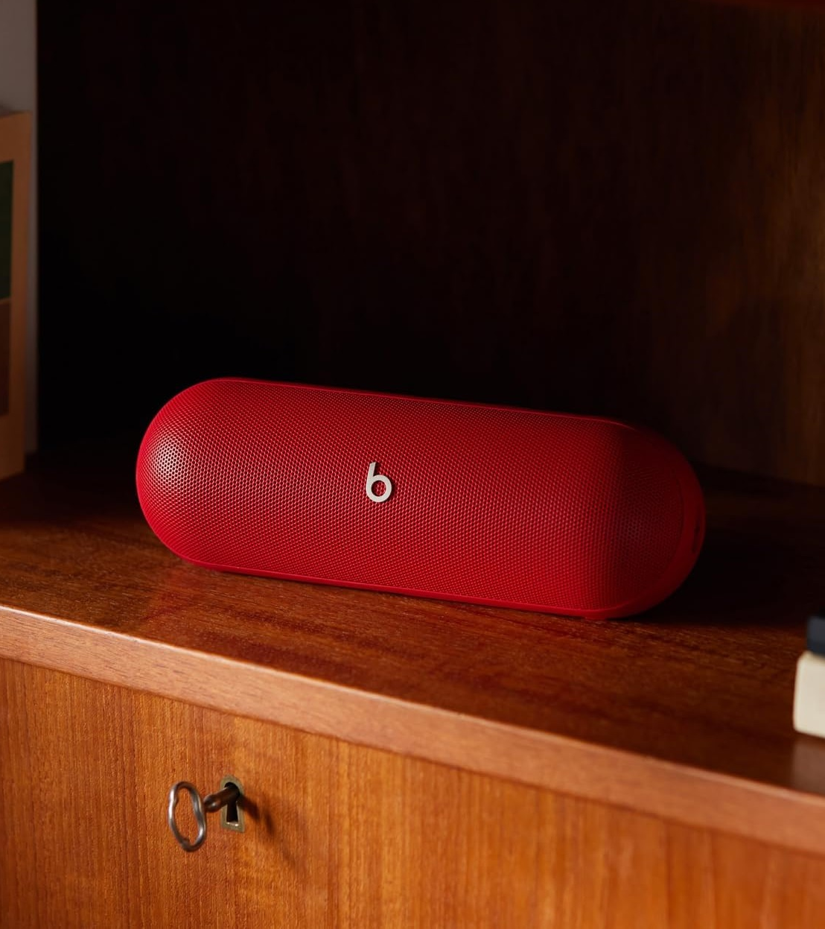
Beats Pill Consumer Insights
By Abdulazeez Saliu
7/10/24

Slide 2
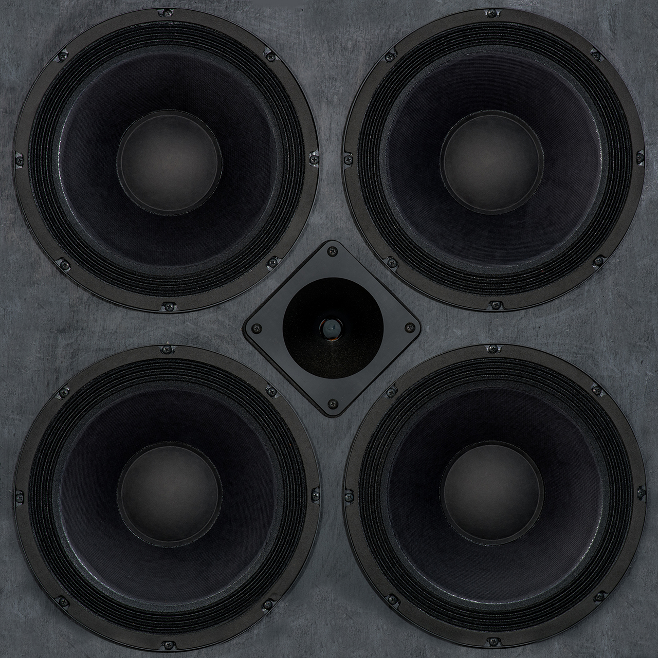
Methodology
Objective :
our objective is to identify key patterns, relationships, insights, sentiments, and common issues highlighted by customers. By systematically analysing the data, we seek to uncover actionable insights that can inform product improvements, marketing strategies, and customer service enhancements for Beats By Dre.
Data Collection Methods :
Amazon reviews
Beats Pill and 10 competing speaker brands
Sample Size :
1085 customer reviews analyzed
85 Beats pill reviews
- Exploratory Data analysis
- Sentiment analysis
-Competitor analysis
-SWOT analysis

Slide 3
Market Position
Beats by Dre Positioning:
Known for premium audio products (headphones, speakers).
Brand power supported by celebrity endorsements and high-quality design.
Competitor Landscape:
Major competitors: Bose, JBL, Sony, Bang & Olufsen.
Product price range: $120–$195 across competitor brands.
Trend Highlights:
Portable, durable, and Bluetooth-enabled speakers dominate the market.

Slide 4
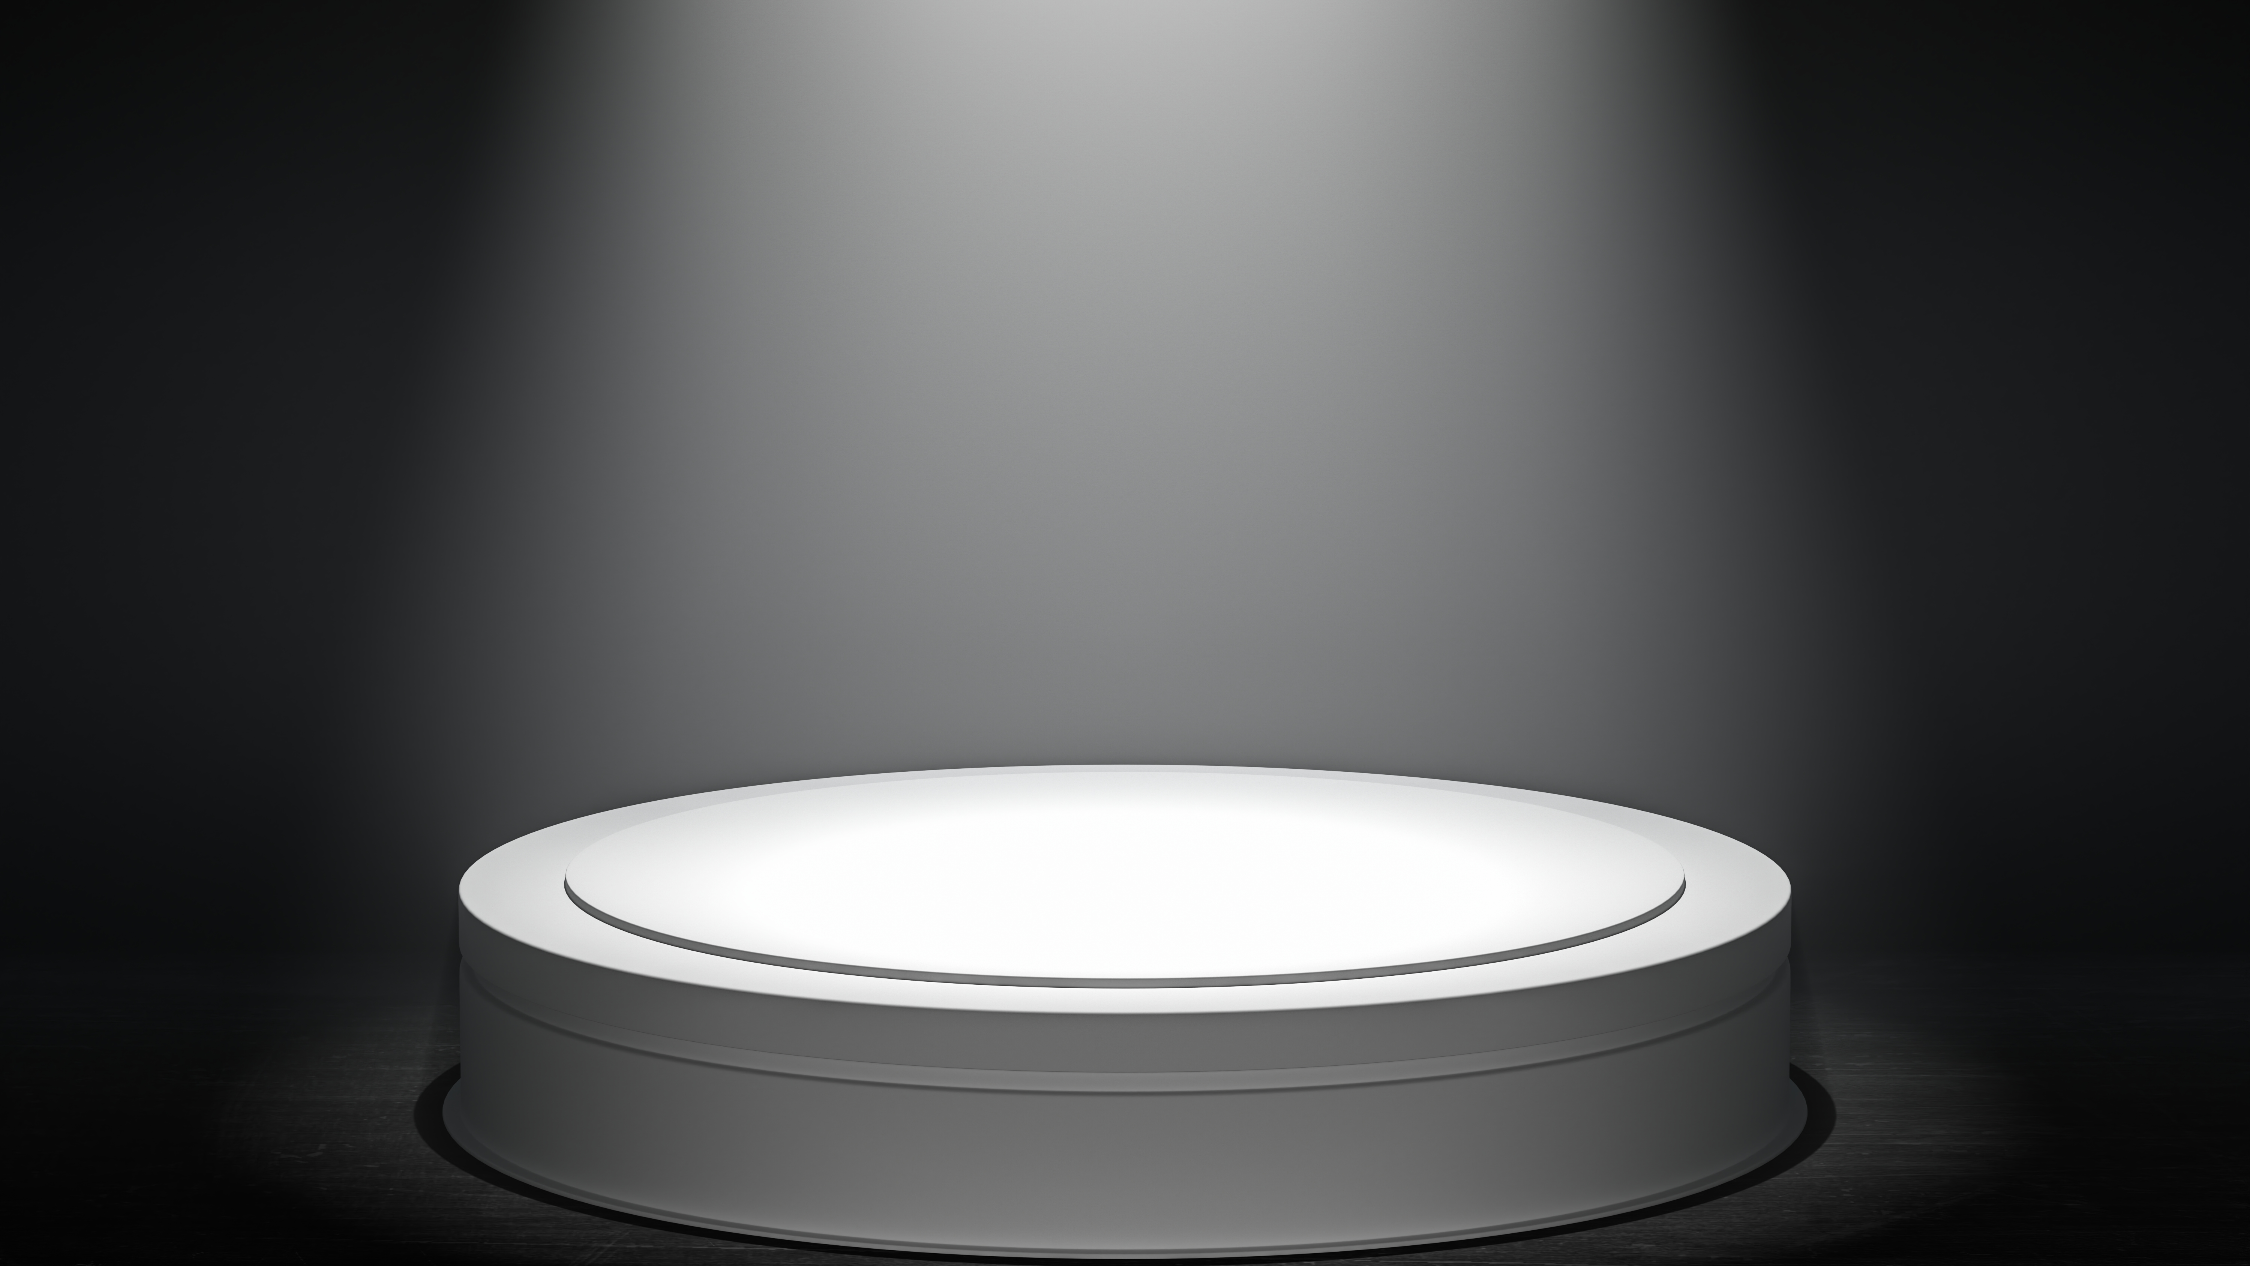
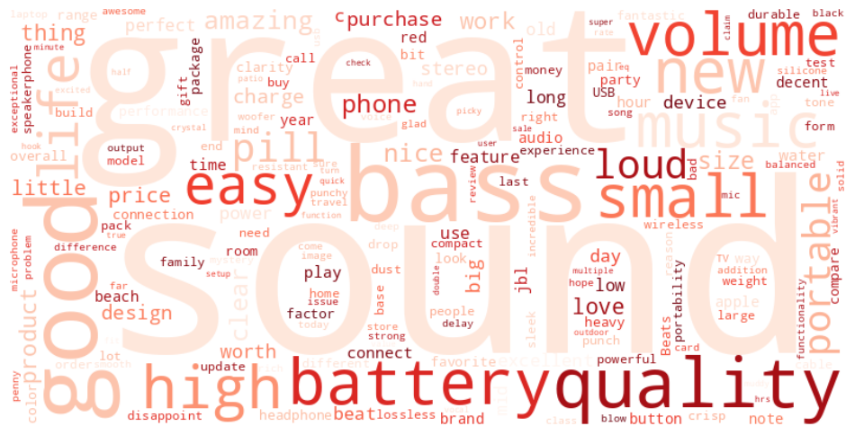
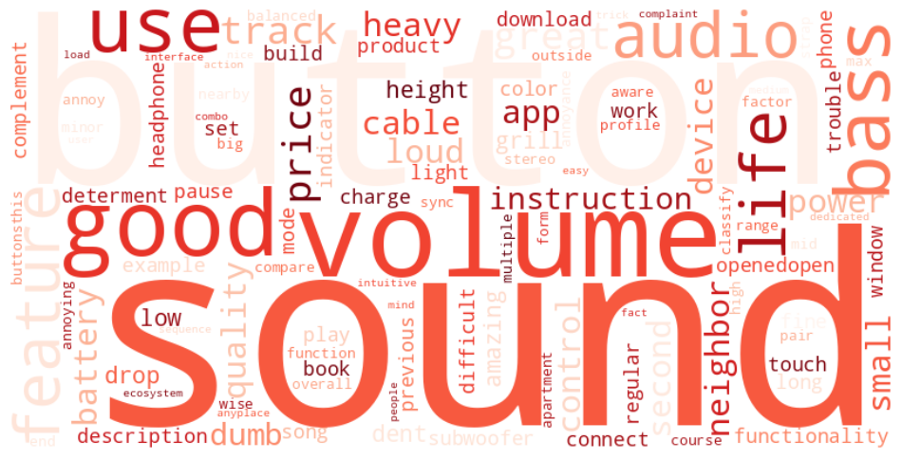
Beats Pill Consumer sentiments
Positive sentiments
Negative sentiments

Slide 5
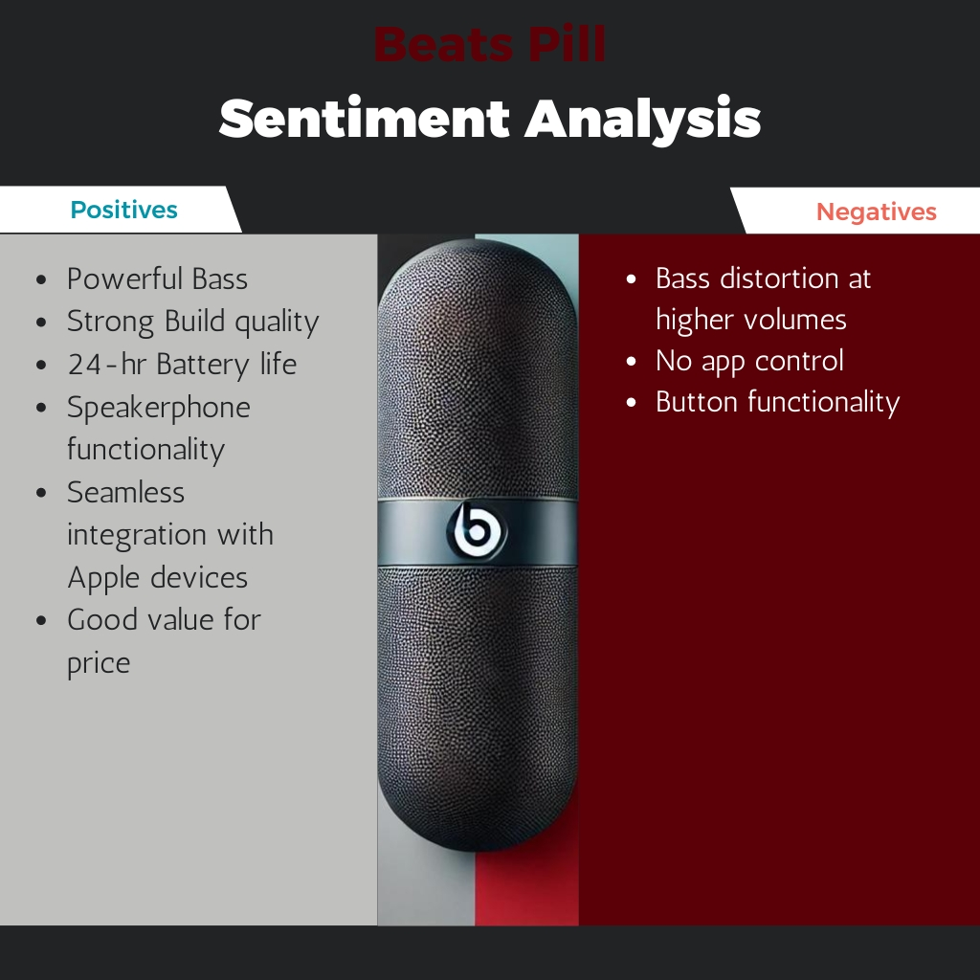
The Beats Pill 2024 is a well-designed, compact, and powerful portable speaker with excellent sound quality, a strong build, and long battery life. However, some limitations like bass distortion at high volumes, lack of app control, and annoying startup/power-off tones may be deal-breakers for some buyers. Ultimately, it's a solid choice for those seeking a portable speaker with a focus on Apple integration and powerful sound.

Slide 6
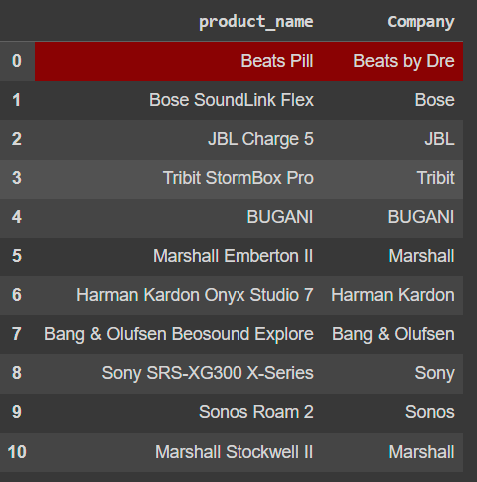
Competitor Analysis
Table showing anlaysed speakers and their manufacturing companies

Slide 7
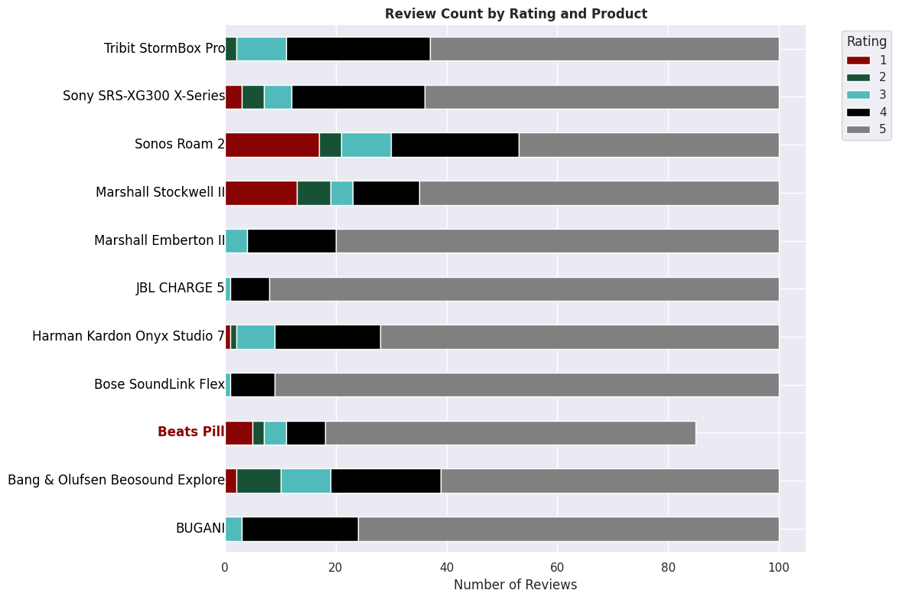
All the speakers are well-received, with a high number of 5-star ratings. The Beats Pill, despite having the least number of reviews, still shows a significant number of 5-star ratings, indicating positive customer reception.

Slide 8
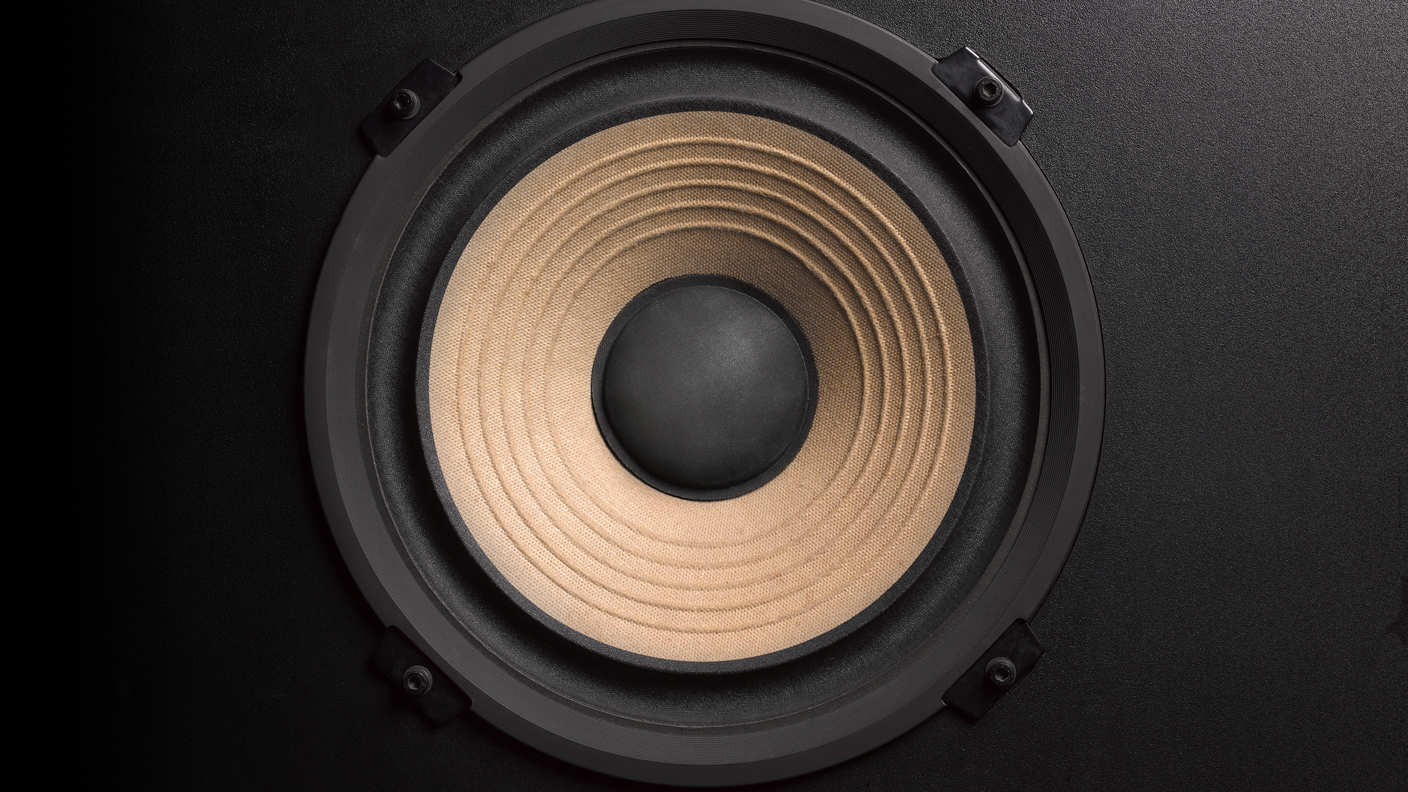
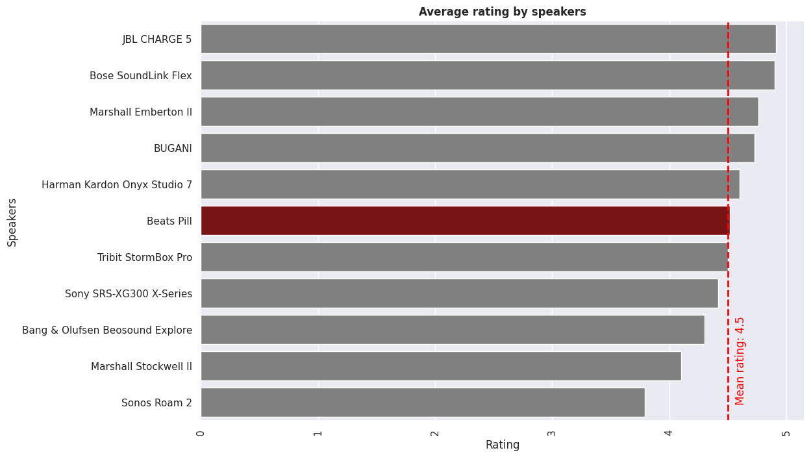
The Beats Pill ranks 5th among the speakers with an average rating of 4.52, which is above the overall average rating of 4.5. This indicates that despite having fewer reviews, the Beats Pill is well-received by customers.

Slide 9
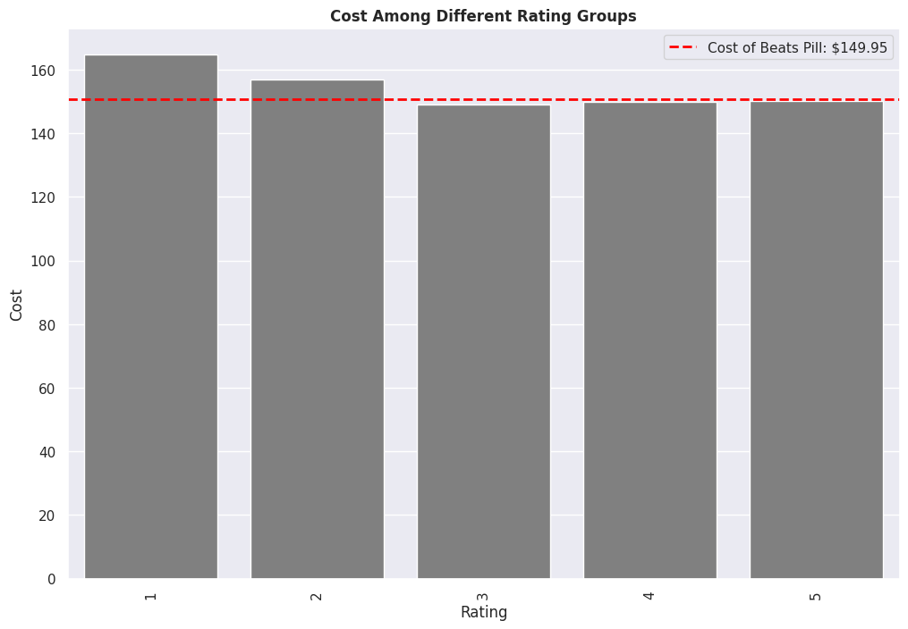
The red dashed line is positioned at 149.95, showing that the cost of the Beats Pill is below the average cost for speakers rated 1 and 2 stars but higher than the average for ratings 4 and 5. This suggests that the Beats Pill is priced competitively compared to higher-rated products.

Slide 10
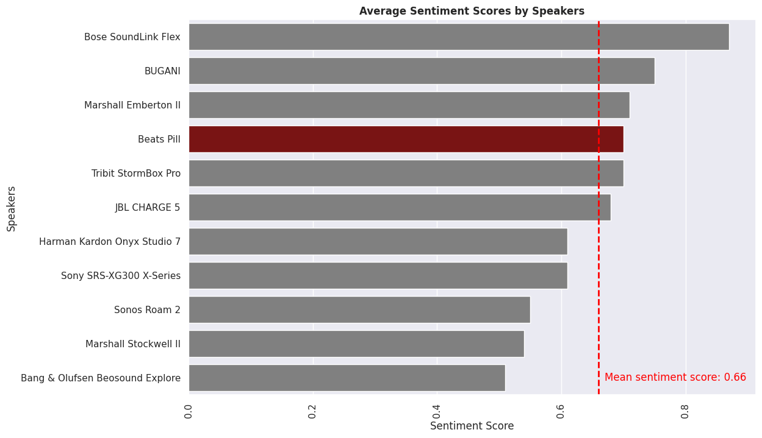
The Beats Pill stands out as one of the most positively reviewed speakers, with an impressive average sentiment score of 0.7. This score is higher than the average sentiment score of 0.66 for other selected speakers, underscoring its popularity and favourable reception. This aligns with the trend of its high ratings.

Slide 11
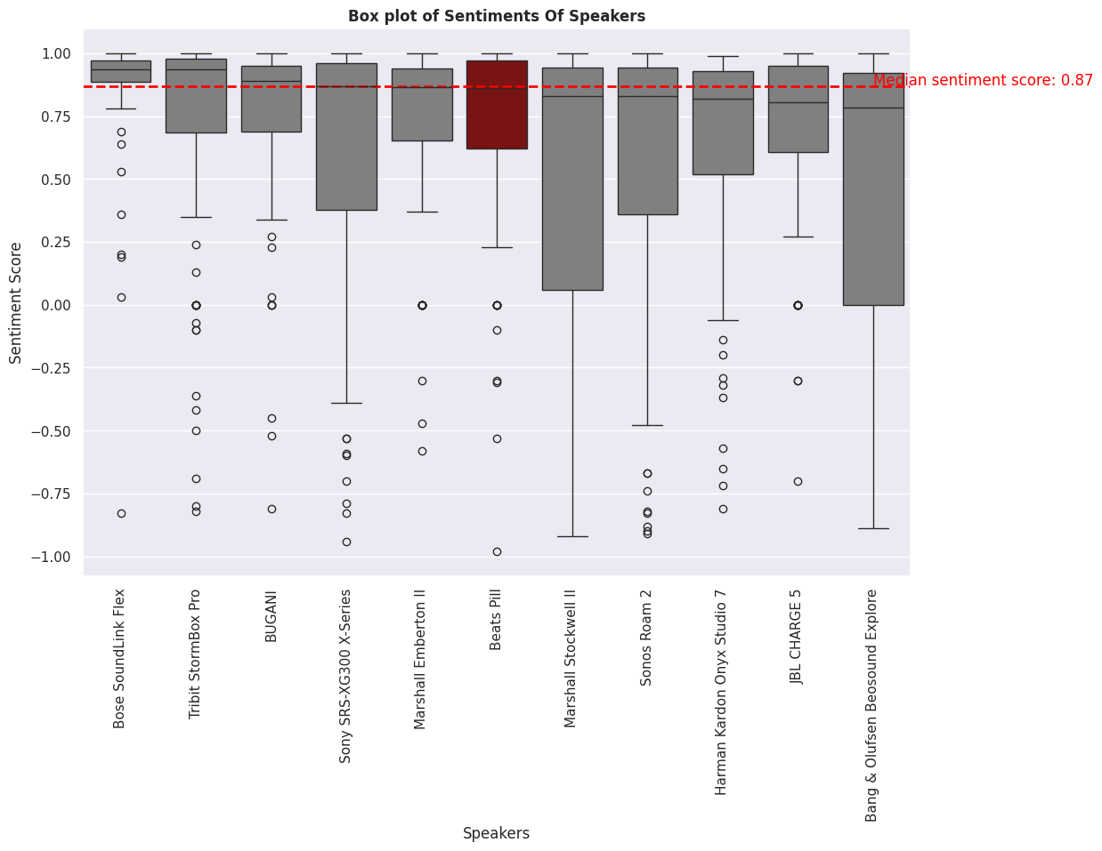
The Beats Pill has a high median sentiment score shows low variability, meaning that user reviews are fairly consistent. While there are a few negative outliers, the overall sentiment is still positive.

Slide 12
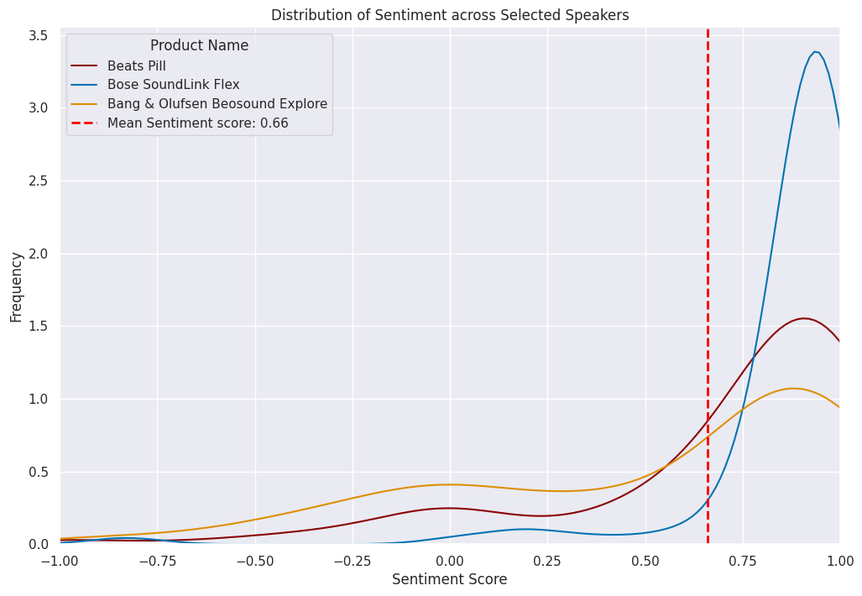
- Bose SoundLink Flex is the most positively reviewed product, with a concentration of highly favourable sentiment.
- Beats Pill has a moderately positive sentiment, but not as overwhelmingly positive as Bose.
- Bang & Olufsen Beosound Explore has a more mixed distribution, with more neutral or slightly negative reviews than the other two products.

Slide 13
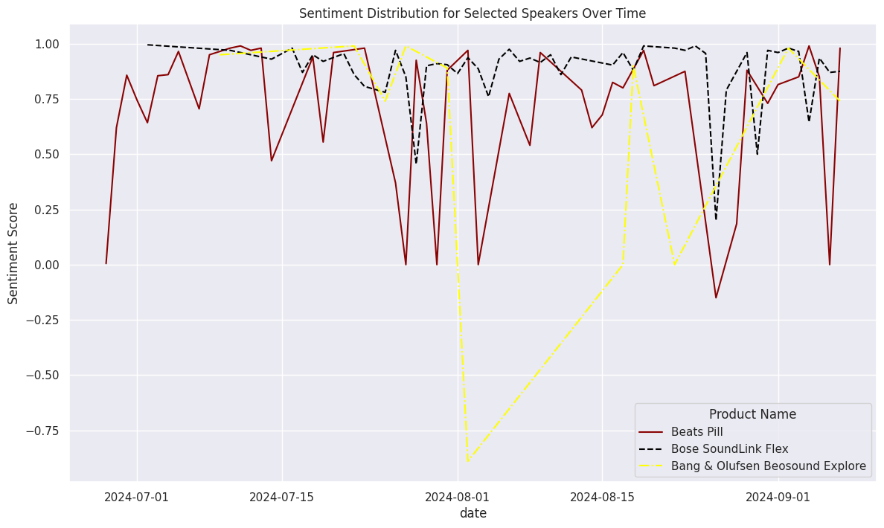
The plot highlights that while the Beats Pill maintains consistent positive sentiment over time, there is a notable increase in negative reviews for all products in August 2024.

Slide 14
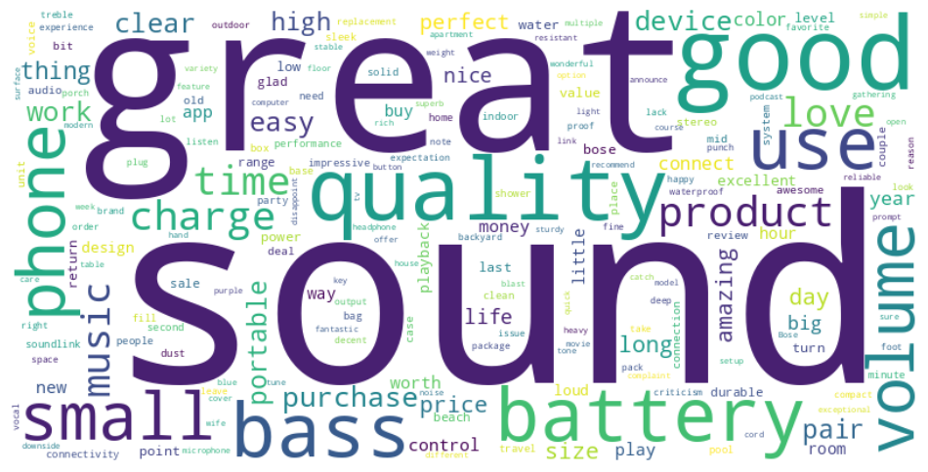
Bose Soundlink
Beats Pill
While both speakers are praised for their sound quality, portability, and battery life. The Beats Pill stands out more for its speakerphone functionality, and bass emphasis. The Bose SoundLink Flex is appreciated for its durability and outdoor usability.

Slide 15
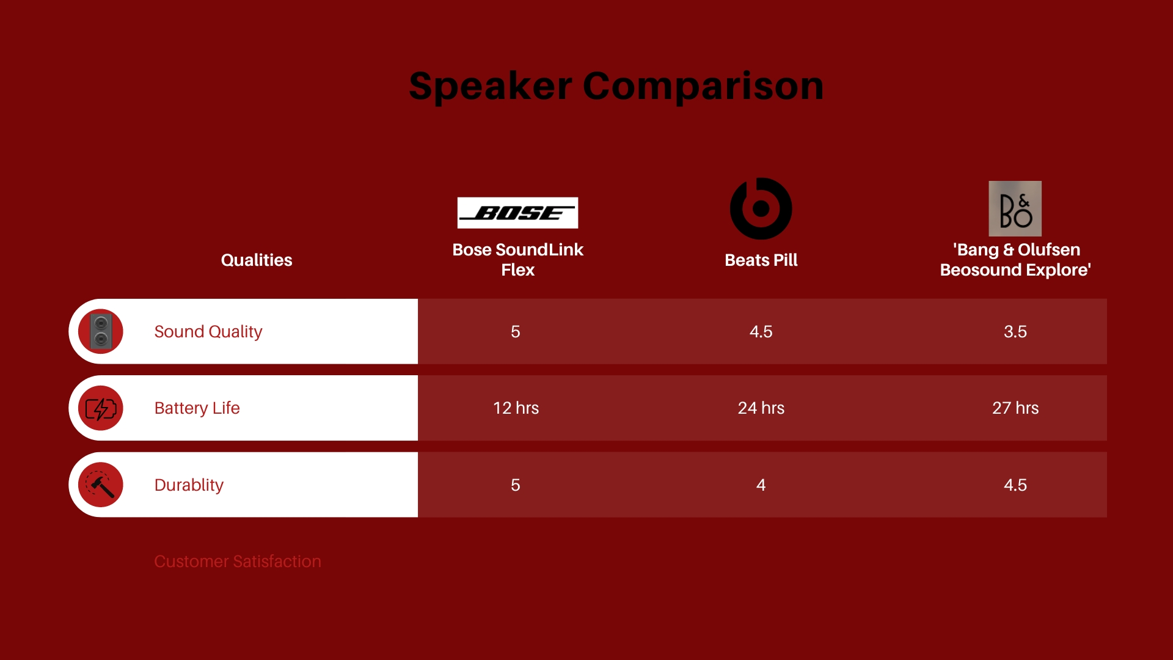

Slide 16
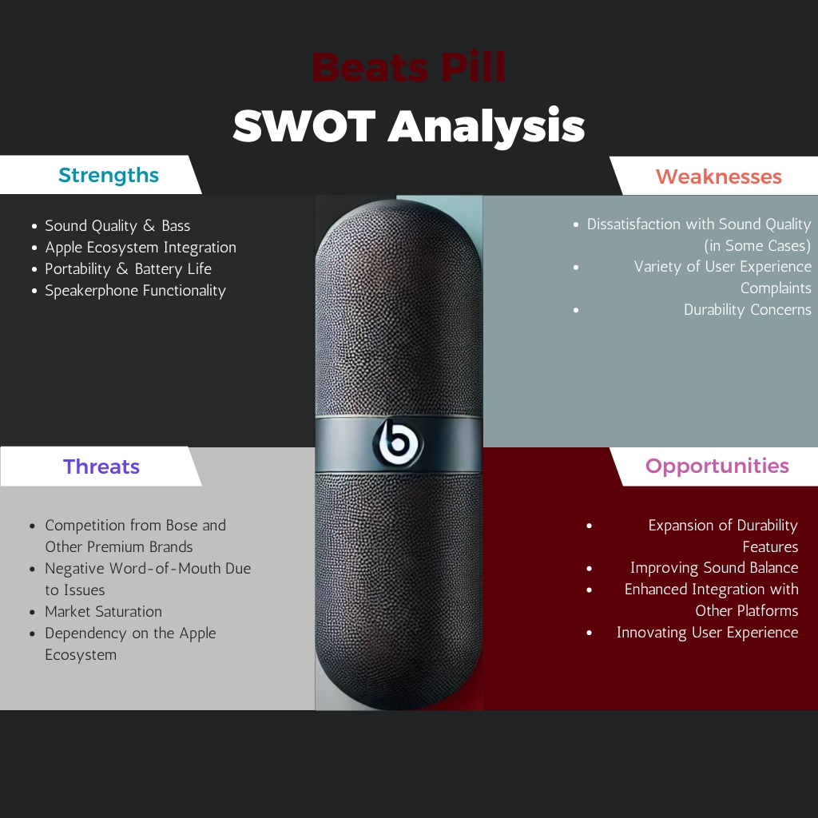

Slide 17
Strategic Recommendations
Product Development :
- Explore battery life enhancements and rugged designs
- Improve button functionality and sound at higher volumes
Marketing Opportunities:
-Leverage Apple ecosystem loyalty with targeted campaigns
- Focus on portability and lifestyle applications in marketing
Customer Service Enhancements :
- Address performance issues reported in August 2024

Slide 18
Conclusion
Summary of insights:
- Beats Pill is well-received but faces challenges in performance at higher volumes
Recommendations:
-Explore product improvements, leverage strong brand identity and enhance customer satisfaction.
Next Steps:
- Investigate new features based on consumer demand and competitive analysis.

